Slide 1
Week2_7 Spatial Weights
CRP 3850
Wenzheng Li
Yujin Lee

Slide 2
Objective
Understand the purpose and conceptual differences between varying spatial weights
Creating spatial weights for different datasets and interpreting their differences

Slide 3
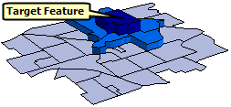
Where are spatial weights used?
Who are our ‘neighbors’?
Calculating Spatial Autocorrelation (spatial dependence) – how much weight do we give to our neighbors when understanding the similarity between me and my neighbors?
Weights are used to create ‘spatially lagged variables’ – averaging the values of ‘neighbors’ as a new parameter

Slide 4
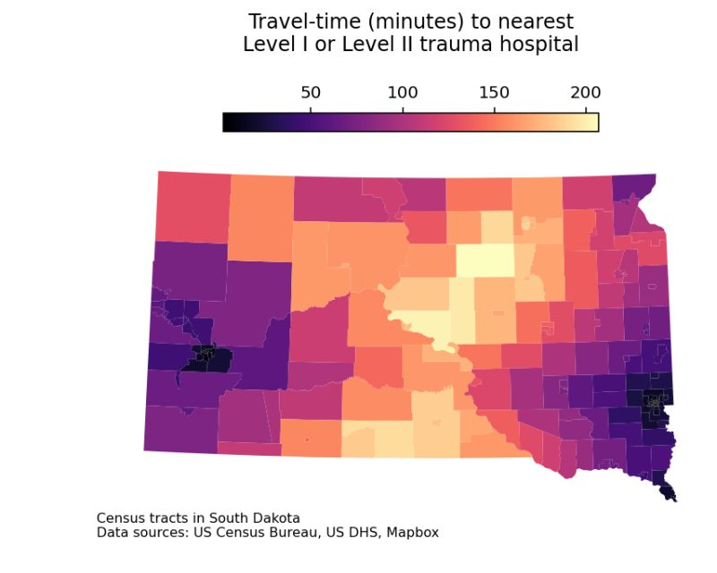
Spatial Weights
Who are our neighbors?
Fundamentally, there are two strategies for creating weights to quantify the relationships among data features:
Contiguity weights – whether a feature is sharing a border with neighbor
Distance weights – setting a threshold (bandwidth) based on distance or number of neighbors

Slide 5
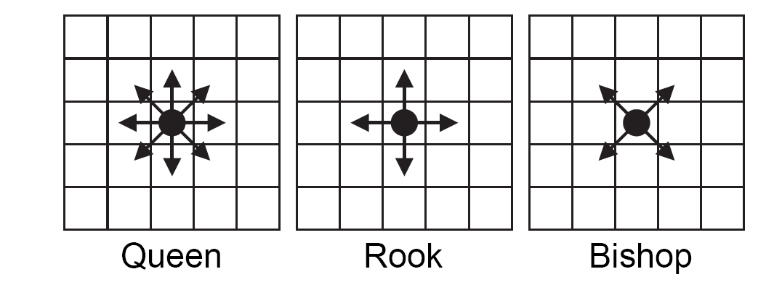
Binary: contiguity weights (rook and queen)
If zone j is adjacent to zone i, the interaction receives a weight of 1, otherwise it receives a weight of 0 and is essentially excluded
effective when polygons are similar in size and distribution and when spatial relationships are a function of polygon proximity (the idea that if two polygons share a boundary, spatial interaction between them increases).
you can define a range of contiguity matrices: 1st nearest, 2nd nearest, 3rd nearest, etc.

Slide 6
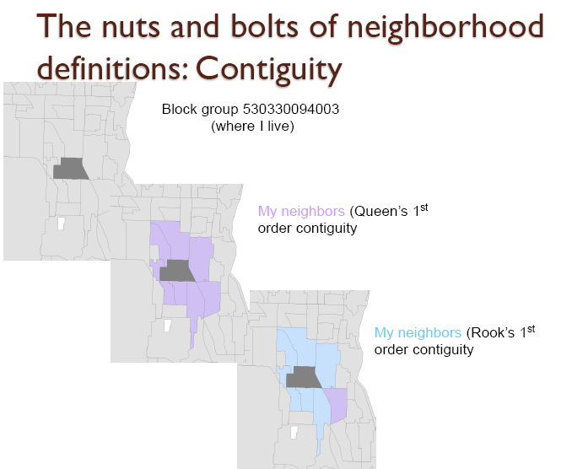
Defining a neighborhood: Contiguity
w_queen = weights.contiguity.Queen.from_dataframe(df)
w_rook = weights.contiguity.Rook.from_dataframe(df)

Slide 7
Rook Weights Matrix Example
Sample Region and Units
Simple Contiguity (rook) Matrix
1 | 2 | 3
4 | 5 | 6
7 | 8 | 9
 | 1 | 2 | 3 | 4 | 5 | 6 | 7 | 8 | 9
1 | 0 | 1 | 0 | 1 | 0 | 0 | 0 | 0 | 0
2 | 1 | 0 | 1 | 0 | 1 | 0 | 0 | 0 | 0
3 | 0 | 1 | 0 | 0 | 0 | 1 | 0 | 0 | 0
4 | 1 | 0 | 0 | 0 | 1 | 0 | 1 | 0 | 0
5 | 0 | 1 | 0 | 1 | 0 | 1 | 0 | 1 | 0
6 | 0 | 0 | 1 | 0 | 1 | 0 | 0 | 0 | 1
7 | 0 | 0 | 0 | 1 | 0 | 0 | 0 | 1 | 0
8 | 0 | 0 | 0 | 0 | 1 | 0 | 1 | 0 | 1
9 | 0 | 0 | 0 | 0 | 0 | 1 | 0 | 0 | 0

Slide 8
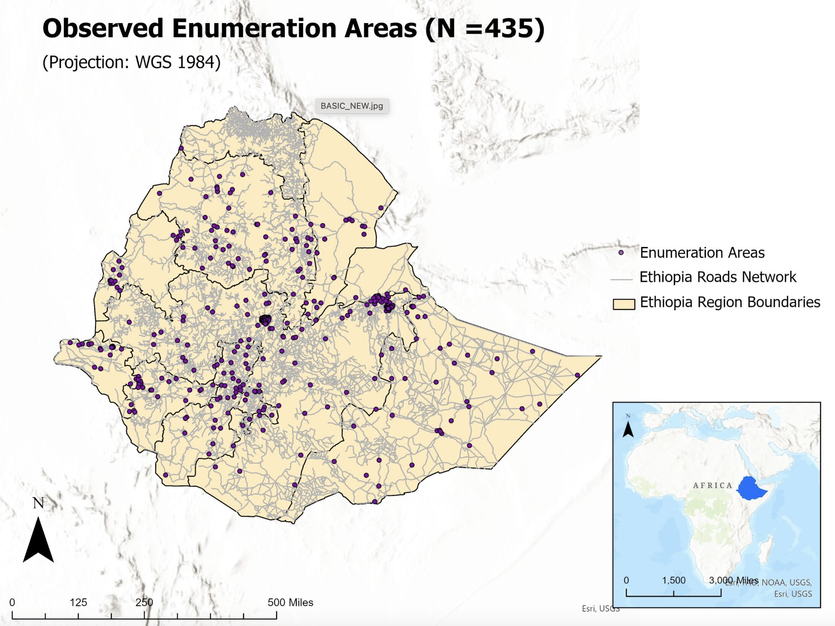
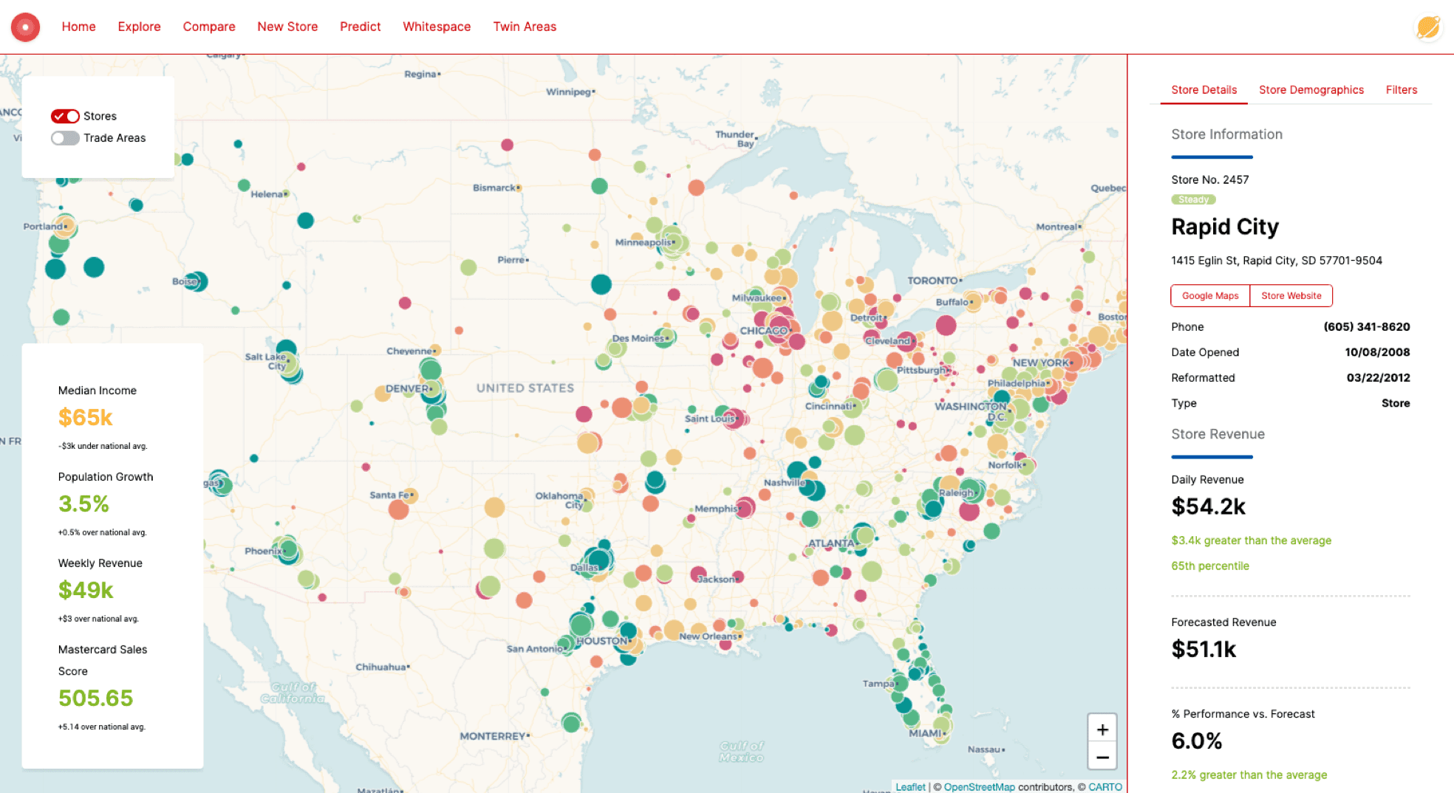
Point data do not have contiguity neighbors.

Slide 9
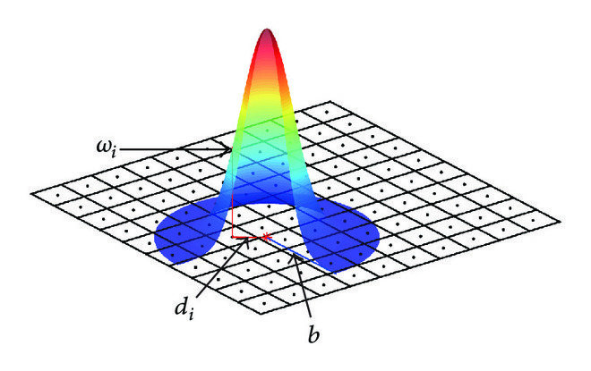
Distance Based Weights
Tobler’s First Law of Geography:
"everything is related to everything else, but near things are more related than distant things”
Figure Assumes Triangular Kernel

Slide 10
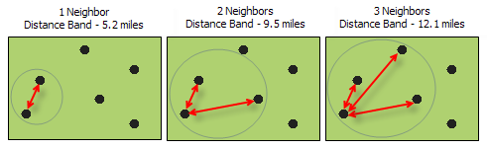
Binary : Distance based - KNN (K-nearest neighbors)
Weights based on each feature is assessed within the spatial context of a fixed number of its closest neighbors.
In locations where feature density is high, the spatial context of the analysis will be smaller.
ensures there will be some neighbors for every target feature

Slide 11
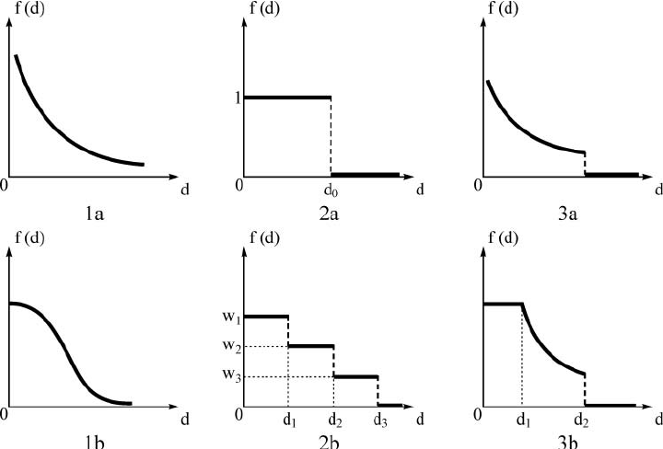
Kernel Weights

Slide 12
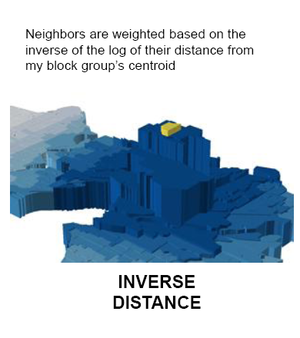
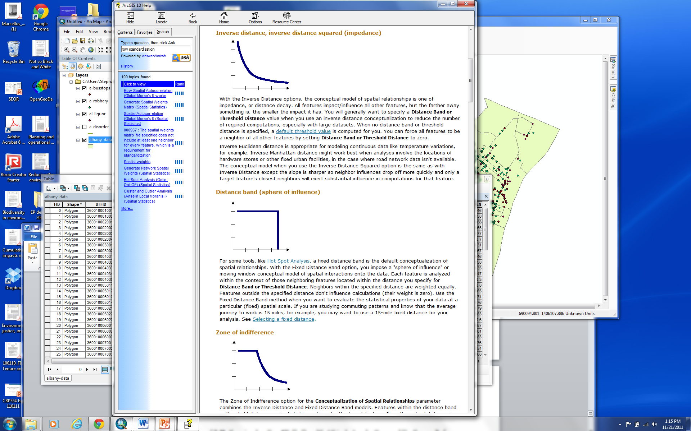
Distance Weights : Kernel distance weights (Inverse distance/ distance decay function)
Default is minimum distance that ensures every feature has at least one neighbor.
You can specify a threshold distance: Features outside the specified cutoff are ignored
You can force all features to be a neighbor of all other features by setting Threshold Distance to zero (large number of computations!).
Appropriate with continuous data or to model processes where the closer two features are in space, the more likely they are to interact/influence each other.

Slide 13
Distance Based : Kernel Density - Distance Band
Each feature is analyzed within the context of neighboring features located within the Threshold Distance (bandwidth). Neighbors within the specified distance are weighted equally.
Features outside the specified distance don't influence calculations (their weight is zero).
If you are studying commuting patterns and know that the average journey to work is 15 miles, for example, you may want to use a 15-mile fixed distance for your analysis.
This works well for polygon data where there is a large variation in polygon size (very large polygons at the edge of the study area and very small polygons at the center of the study area, for example).
Fixed distance bandwidth is determined
by python based on maximum knn=2

Slide 14
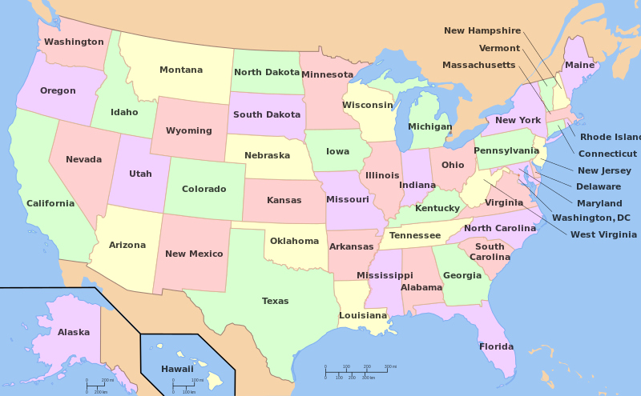
Distance Weights: Adaptive Bandwidths
Some regions have differing densities, so the number of neighbors may differ significantly
Apply a specific bandwidth (i.e. number of neighbors) for every unit of observation – applying a bandwidth so that every observation would have the same number of neighbors
Very similar to KNN but the underlying principle is different

Slide 15
Distance Band and Hybrid Weights
Binary distance or threshold distance weights to a certain bandwidth and then 0 values
Distance bandwidth is determined
by user - hyperparameter
Binary Distance Band
Threshold Distance Band

Slide 16
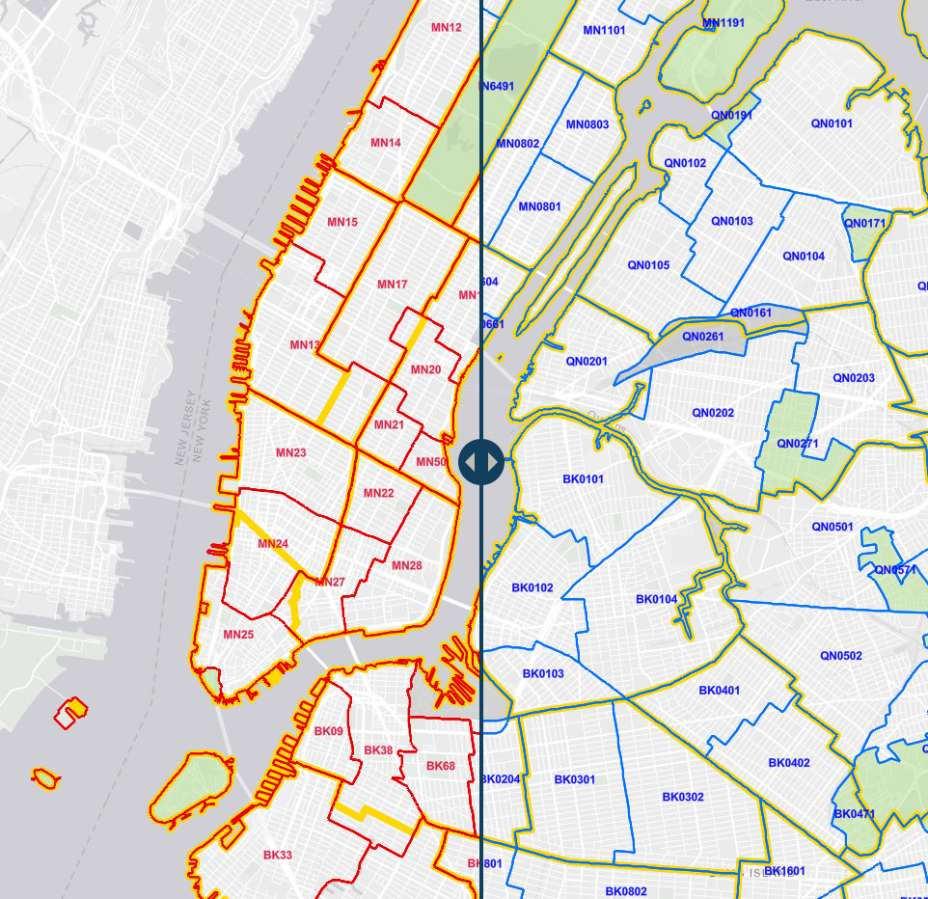
Binary Distance Based - Block Weights
Similar to clustering standard errors – observations that are within the same larger unit (i.e. administrative boundaries – census tracts in zipcodes, counties in a state, nations in a continent) are considered neighbors
(source: NYC planning)

Slide 17
Weights | Types, Description
Contiguity Weights | Rook, Queen
Distance based - KNN | Specific number of neighbor for each observation
Distance based - Kernel Weights | Inverse Distance, Fixed Distance (distance decided by python)
Distance based - Adaptive Bandwidth Weights | Bandwidth differing for every unit of observation (i.e. # of neighbors) –distance band differs for each observation
Distance based - Distance bands and hybrid weights | Can be both binary or non-binary values + distance decided by researcher as a hyperparameter
Block Weights | Based on membership in a specific geographic group

Slide 18
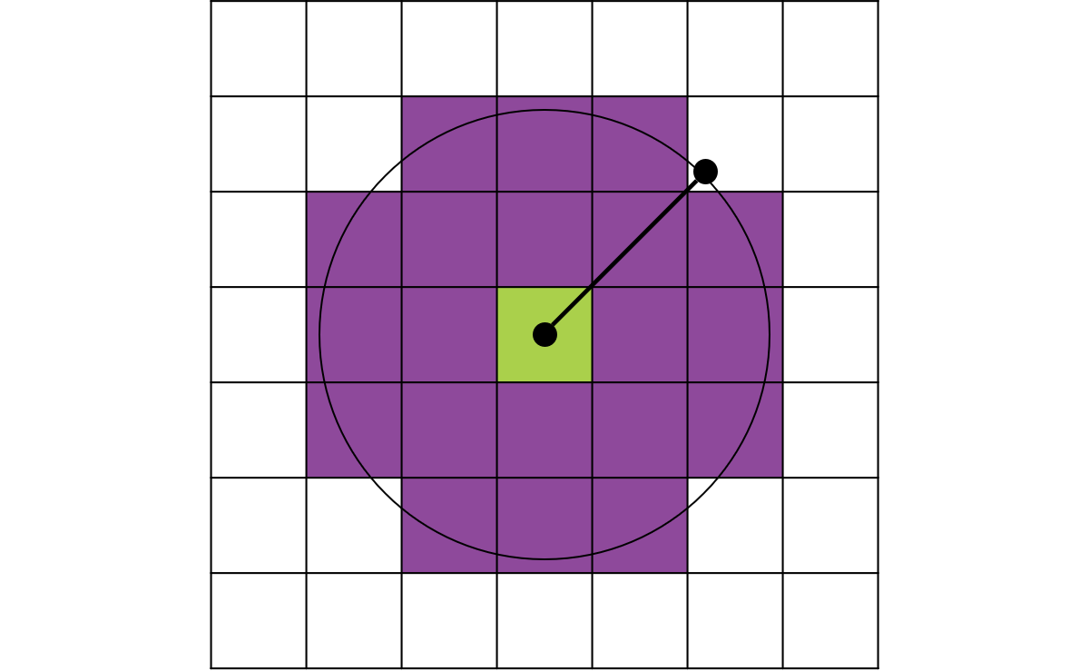
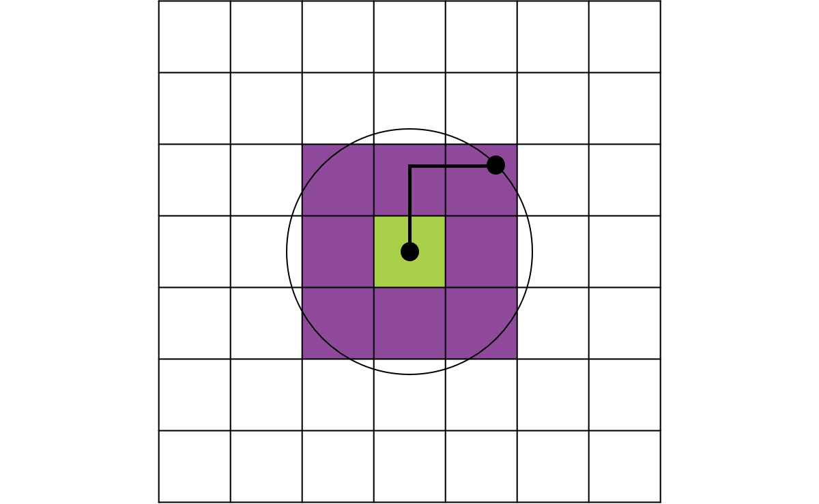
Distance Methods
Specifies how distances are calculated from each feature to neighboring features.
EUCLIDEAN DISTANCE: The straight-line distance between two points (as the crow flies)
MANHATTAN DISTANCE: The distance between two points measured along axes at right angles (city block); calculated by summing the (absolute) difference between the x- and y-coordinates

Slide 19
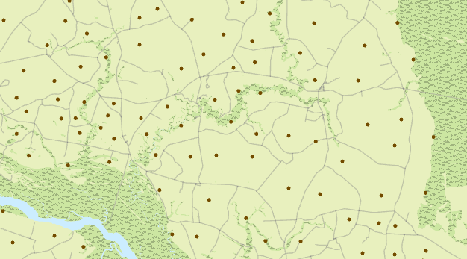
Standardization
Sampling design bias refers to data sampling that may not reflect the underlying spatial distribution of the data that you want to analyze. This bias can be a result of ease of access, weather, political boundaries, or other factors that can affect data collection.
Standardization adjusts the analysis to accommodate for different types of potential bias in your data.

Slide 20
Row Standardization
Row standardization is recommended whenever the distribution of your features is potentially biased due to features having different numbers of neighbors
Common if you are working with polygon features representing administrative boundaries.
Row standardization will scale all weights so they are between 0 and 1, creating a relative, rather than absolute, weighting scheme. Each weight is divided by its row sum (the sum of the weights of all neighboring features).

Slide 21
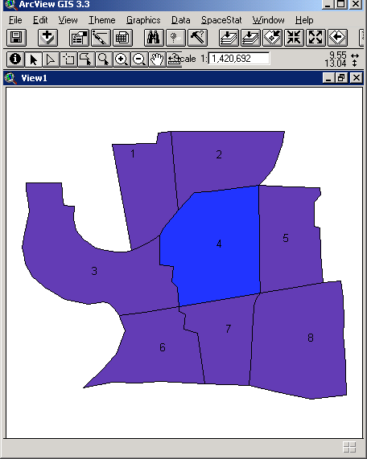
Row standardization
1
2
3
4
5
6
7
8
1
0
1
1
1
0
0
0
0
2
1
0
0
1
1
0
0
0
3
1
0
0
1
0
1
0
0
“unstandardized”
4
1
1
1
0
1
0
1
0
5
0
1
0
1
0
0
0
1
6
0
0
1
0
0
0
1
0
7
0
0
0
1
0
1
0
1
8
0
0
0
0
1
0
1
0
1
2
3
4
5
6
7
8
1
0
.33
.33
.33
0
0
0
0
2
.33
0
0
.33
.33
0
0
0
3
.33
0
0
.33
0
.33
0
0
“standardized”
4
.2
.2
.2
0
.2
0
.2
0
5
0
.33
0
.33
0
0
0
.33
6
0
0
.5
0
0
0
.5
0
7
0
0
0
.33
0
.33
0
.33
8
0
0
0
0
.5
0
.5
0
Notes:
If you make it 1 (unstandardized) then it’s a sum
Rook contiguity weights matrix – Area 8

Slide 22
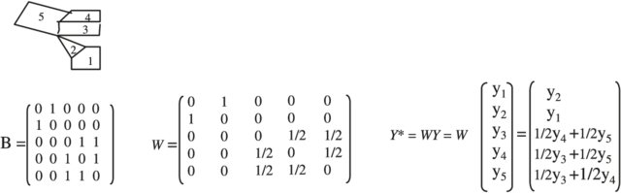
Our Map
Matrixes = (N of rows X N of columns)
(NXN) X (NX1) = (NX1)
Original weights matrix
Row standardized weights matrix
Spatially lagged variable

